Slide 1
Energy! Conserve! Recycle!
Giving life to automated systems around the world

Slide 2
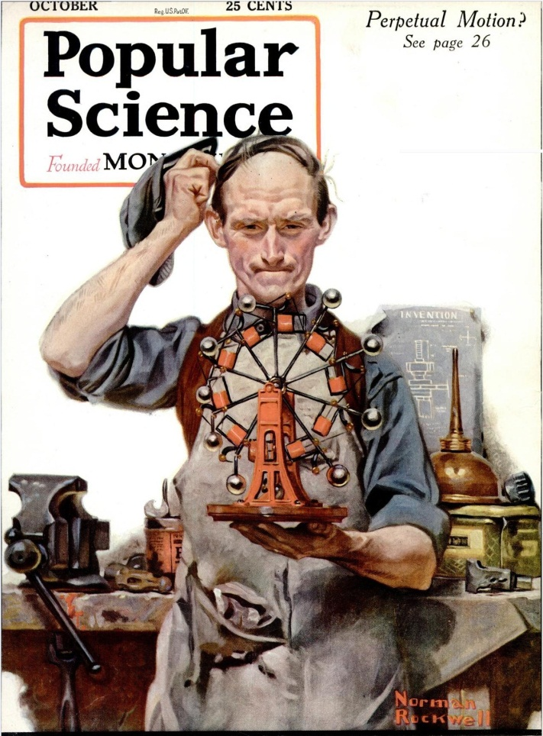
Endless energy?

Slide 3
Groups!
Hour 1
Andrea / Jenny / Julia
Alex / Whitney
Kaitelyn / Maeve / Brianna
Lilly / Maddie / Gabby
Nate / DJ / Braedon

Slide 4
Groups!
Hour 4
Matt / Zach R / Martin
Joe / Cameron / Alex J / Victor
Zack Z / Carson / Rafael
Finlay / Robert / Aaron / Gabe
Rebecca M / Allie / Ashlynn
Rebecca B / Elliana / Amber / Althea
Diana / LeAnn / Sam N
Elizabeth / Hannah / Maddie R
Olivia / Luz / Maddie D

Slide 5
Energy and the Environment
How do we get the energy needed to run an automated world?

Slide 6
Energy and the Environment
Today, I would like you to work in your groups to create some art. It must have color!
Divide a large piece of paper into 3 sections.
In one section write the word “ENERGY” and find pictures or draw pictures to show as many types of energy as you can think of.
In a second section write the word “CONSERVE” and find pictures or draw pictures to show all the ways to conserve that you can think of
In the third section write the word “RECYCLE” and find pictures or draw pictures to show all of the ways you can think of to recycle materials or objects.

