Slide 1
Energy Conservation
If we are not ready for alternative energy, let’s at least conserve what fossil fuels are still left.

Slide 2
Although Alternative energy will be our future, there are ways to put off the need for them by conserving what we already have.

Slide 3
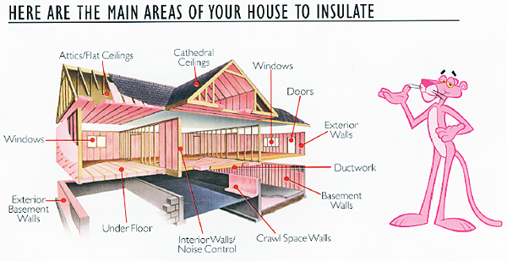
Conserve Energy by Insulating
One of the easiest way to conserve energy is by insulating. This keeps cold air out in winter and warm air out in summer.

Slide 4
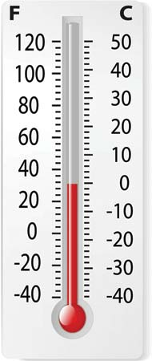
Measure and Record insulating properties
Today you will be comparing various materials and measuring their insulating qualities.
Your group will take 3 different materials and:
Record their initial temperature
Place them in the solar oven for 15 minutes
Record a final temperature

Slide 5
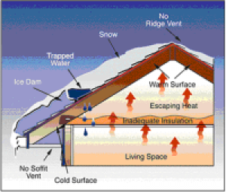
What do you want to measure?
As a group, decide if you want to compare different materials, different colors, different places in the oven, etc.
What do you want to know?

Slide 6
Chart your data
Please make a chart like this in a group members notebook:
Material | Initial Temp | Prediction | Final Temp | Conclusion

Slide 7
Chart your data
Please make a chart like this in a group members notebook:
Material | Initial Temp | Prediction | Final Temp | Conclusion
Red Felt | 72 | 78
Red Foam | 72 | 75
Red Construction Paper | 72 | 84

Slide 8
While you are waiting…
Please go to:
http://www.electrocity.co.nz/
You will act as mayor of your own city, and will need to make energy decisions in order to keep your citizens happy.

Slide 9
Penguin Groups – Hr 1
Gabby / Brianna / Braeden / DJ
Nate / Maeve / Whitney / Julia
Andrea / Jenny / Alex
Maddie / Kaitlen/ Lilly

Slide 10
Penguin Groups – Hr 4
Finlay / Aaron / Zach R
Maddie D / Rebecca B / Matt P
Amber / Ally/ Hannah /
Martin / LeAnn /Maddie R
Alex / Robert /Cam
Carson T / Gabe / Joe
Zach Z / Rafael / Victor
Elizabeth / Elliana/ Olivia
Ashlynn / Althea
Sam/ Luz / Rebecca M

Slide 11
Penguin Dwellings
Budget, Build, and protect some poor, flightless birds

Slide 12
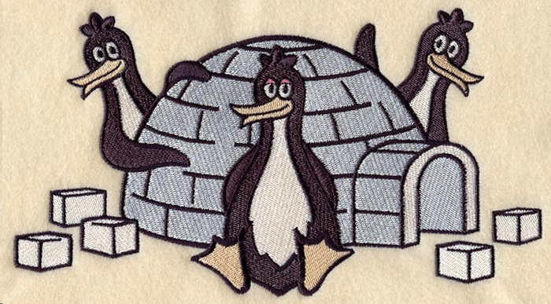
Build!
Build a home for our chilly friends to protect them from increasing temperatures.
Your structure must stand on its own and be able to hold a small cup.

Slide 13
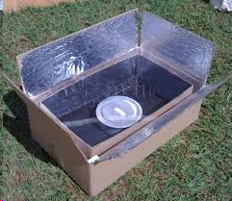
Test
Tomorrow we will place our Penguin Homes in a “Solar Oven” and heat it using a heat lamp for 20 minutes.
At the end of 20 minutes we will see which penguins has survived and which have melted

Slide 14
Budget

Slide 15
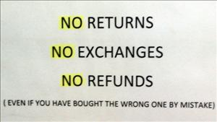
Igloo Depot
You break it, you buy it!

Slide 16
When you are finished…
Please go to:
http://www.electrocity.co.nz/
You will act as mayor of your own city, and will need to make energy decisions in order to keep your citizens happy.

Slide 17
For your viewing pleasure…
1 2 3

Slide 18
Calculating % Survival
Penguin Name | Original Mass | End Mass | % Survival
Walter | 14.88 gr | 12.11 gr | 81.38%
% Survival = (End / Original) x 100
Example: 12.11 / 14.88 = .8138 → x 100 = 81.38%

