Slide 1
Automation and Programming
Some get started tips…
Everyone please log into RobotC !

Slide 2
Find the Coding Errors…
What is wrong with this code?
Answer:
“startMotor “–not “goMotor”

Slide 3
Find the Coding Errors…
The motors don’t run, why not?
Answer:
There is no command between start and stop motor, so the motor does not even respond to the start command

Slide 4
Find the Coding Errors…
What is wrong with this code?
Answer:
Missing a semicolon after line 11

Slide 5
Find the Coding Errors…
Challenge Problem
Your run this program, and the wheels do not stop no matter what you do. There is a problem with the “Open Loop” command.
What is it?
Answer:
Should only have one curly bracket before “while”, the other has to be after “while” and before the first line of code

Slide 6
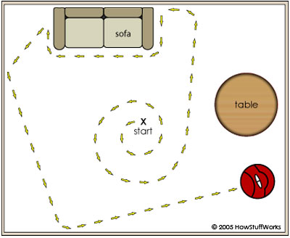
Your review challenge of the day!
You have a job interview with the Roomba Company as an engineer for it’s vacuuming robot.
Here is the first question on your job interview questionaire…

Slide 7
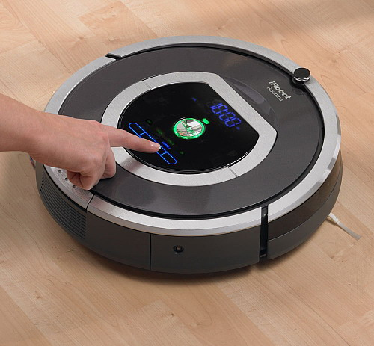
“Forward and back”
Task Description: Wait for the bumper switch to be bumped before both motors turn on at half speed.
Wait until the sensor is bumped again. Both motors should then move in reverse at half power for 3.5 seconds
Write a RobotC program for this task, assuming the wheels on your testbed are the roomba wheels.

Slide 8
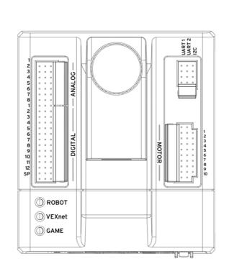
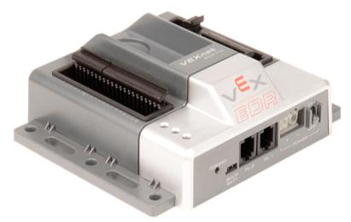
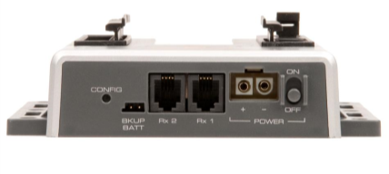
Cortex
The VEX Cortex Microcontroller coordinates the flow of information and power on the robot. All electronic system components must interface to the Microcontroller.
The Microcontroller is the brain of every VEX robot.

Slide 9
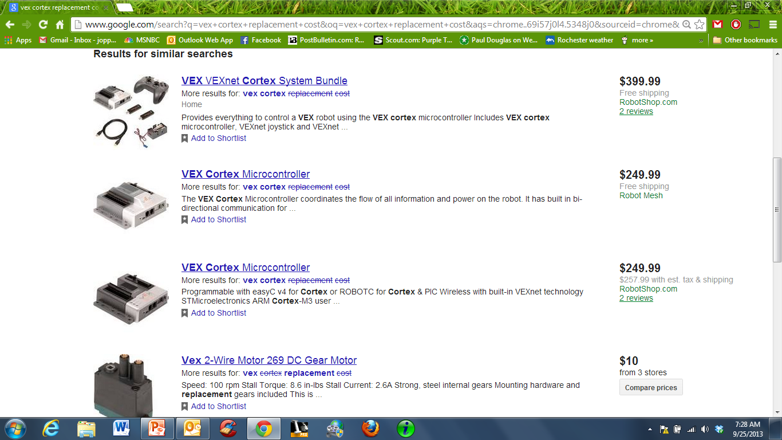
VEX Cortex
The cortex is the most expensive part in the VEX world. Please treat it as if it were your baby brother or sister. No dropping, throwing, or shaking it.

Slide 10
1. Make sure you are set on natural Language

Slide 11
2. Check the Communication Mode

Slide 12
3. Check Your Preferences : Only 1 item should be checked

Slide 13
4. Open a file or open a new file
The Last few programs you worked on will be down here…

Slide 14
Once you Have a program written… Compile and Download – Then…

Slide 15
DeBug Your Program! 1. Robot 2. “Debugger Windows” 3. Sensors

Slide 16
Sensor Values!

Slide 17
5a. Look at the motors and Sensors

Slide 18
5b. Choose the GTT Testbed

Slide 19
5c. Look at the sensor ports

Slide 20
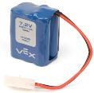
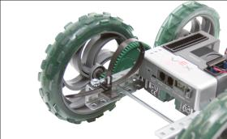
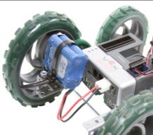
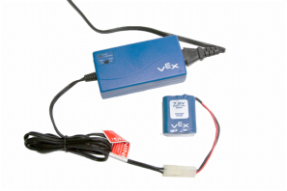
Power
Keep batteries charged – In order for a robot to operate, it needs a power source.
A 7.2V NiCd rechargeable battery is used with your VEX robot.
Attach a battery strap to your model.
When your team is ready to test your model, retrieve a battery from the container of charged batteries. Attach the battery to the model using the strap and plug in to the Cortex.
At the end of class put your battery on the VEX charger so it will be ready for the next class.
Notes:
Battery life and batteries in general are well explained in the VEX Inventors Guide (Power). Page 4.9 describes how to revive batteries that appear weak due to “voltage drop” sometimes referred to as memory effect.

Slide 21
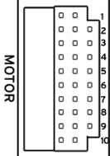
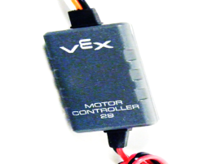
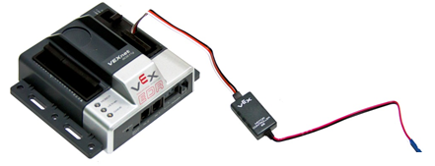
Motors
2-wire motors can be connected directly to ports 1 and 10 on the VEX Cortex
The VEX Motor Controller 29 allows you to connect the VEX 2-wire Motors to any of the standard 3-wire ports on the VEX Cortex.
To use the VEX Motor Controller 29, plug the 3-wire end into one of the MOTOR ports (2-9) on your VEX Cortex Microcontroller.

Slide 22
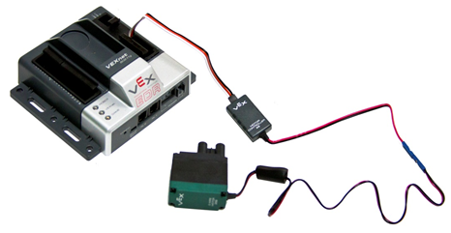
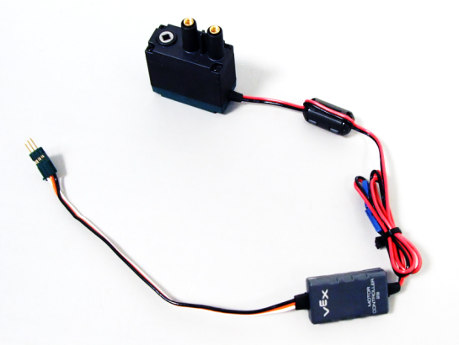
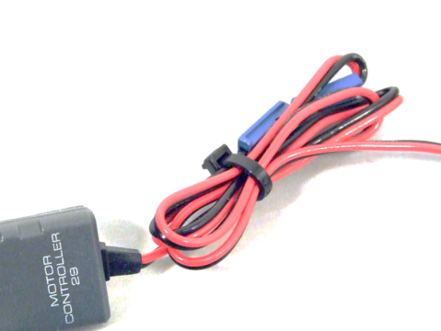
Motors
Connect the other end of the VEX Motor Controller to the 2-wire Motor. Be sure to align the black and red wires.
To prevent the 2-wire Motor and Motor Controller wires from accidentally separating while the robot is running, use the supplied wire ties to secure the two ends, along with any excess wire.

Slide 23
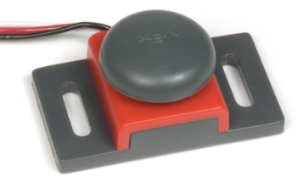
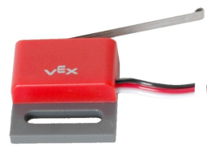
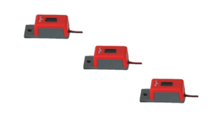
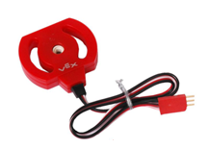
Sensors
4 Sensors:
Touch /
Bumper Switch
Limit Switch
Line Tracker
Potentiometer
Notes:
Sensors are used so the robot can sense its environment, and the robot can adjust its own behaviors based on that knowledge. A sensor will generally tell the robot about one very simple thing in the environment, and the robot’s program will interpret that information to determine how it should react. The Bumper Switch sensor, for instance, will tell the robot whether it is in contact with a physical object or not. Depending on how the sensor is set up, this can tell the robot a lot of different things. If the sensor is mounted on the front bumper, the robot could use this information to tell whether it has run into an obstacle, like a wall inside a maze.
By making good use of sensors to detect the important aspects of its environment, a robot can make things much easier for its human operator. A robot can even operate completely independent of human control, autonomously.

Slide 24
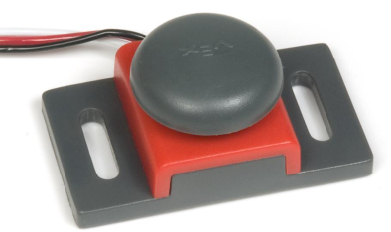
Bumper Switch Sensor
Signal: Digital
Sensor Values: 1 = pressed, 0 = released
Description: The bumper sensor is a physical switch. It tells the robot whether the bumper on the front of the sensor is being pushed in or not.
Type: SPST switch (“Single Pole, Single Throw”) configured for Normally Open behavior.
Signal Behavior:
Notes:
Signal Behavior: When the switch is not being pushed in, the sensor maintains a digital HIGH signal on its sensor port. This High signal is coming from the Microcontroller. When an external force (like a collision or being pressed up against a wall) pushes the switch in, it changes its signal to a digital LOW until the switch is released. An unpressed switch is indistinguishable from an open port.

Slide 25
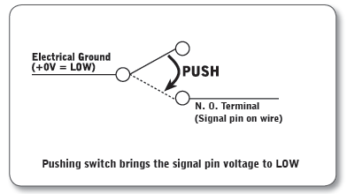
Limit Switch Sensor
Signal: Digital
Sensor Values: 1 = pressed, 0 = released
Description: The limit switch sensor is a physical switch. It can tell the robot whether the sensor’s metal arm is being pushed in or not.
Type: SPDT microswitch, configured for SPST Normally Open behavior.
Signal Behavior:
Notes:
Signal Behavior: When the switch is not being pushed in, the sensor maintains a digital HIGH signal on its sensor port. This High signal is coming from the Microcontroller. When an external force (like a collision or being pressed up against a wall) pushes the switch in, it changes its signal to a digital LOW until the switch is released. An unpressed switch is indistinguishable from an open port.

Slide 26
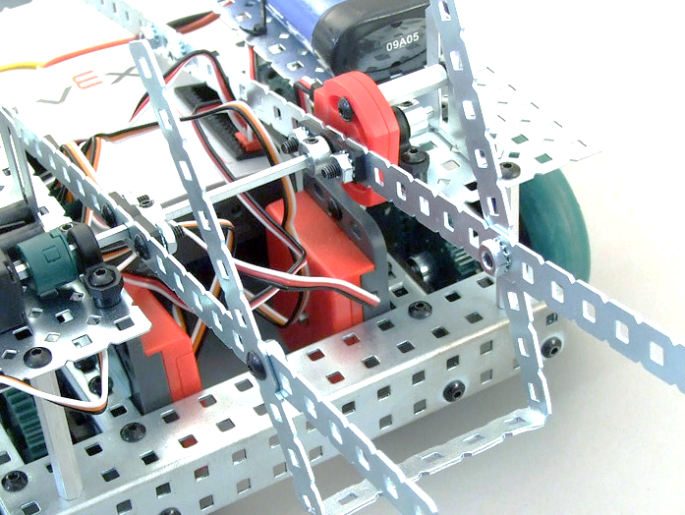
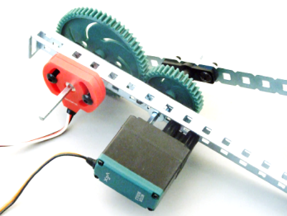
Potentiometer
Signal: Analog
Sensor Values: Range from 0-4095
Description: The Potentiometer is used to measure the angular position of the axle or shaft passed through its center. The center of the sensor can rotate roughly 265 degrees and outputs values ranging from 0-4095 to the Vex Microcontroller.
Mounted Potentiometer
CAUTION! When mounting the Potentiometer on your robot, be sure that the range of motion of the rotating shaft does not exceed that of the sensor. Failure to do so may result in damage to your robot and the Potentiometer.

Slide 27
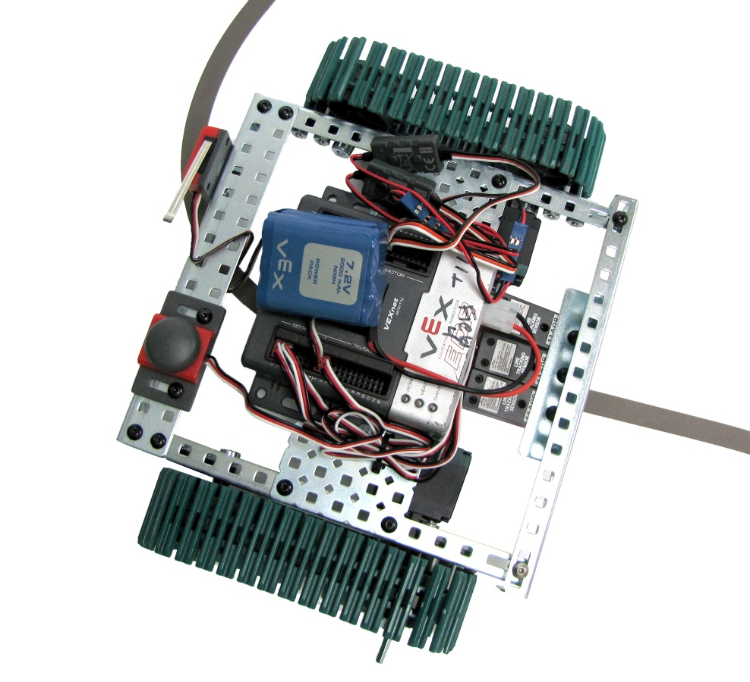
Line Tracker
Signal: Analog
Sensor Values: Range from 0-4095
Description: A line follower consists of an infrared light sensor and an infrared LED. It works by illuminating a surface with infrared light; the sensor then picks up the reflected radiation and, based on its intensity, determines the reflectivity of the surface. Light colored surfaces will reflect more light than dark surfaces. This allows the sensor to detect a dark line on a pale surface, or a pale line on a dark surface.

Slide 28
LineFollower or Potentiometer

Slide 29
LineFollower or Potentiometer

