Slide 1
Secret Life of Garbage and Recyclables
…or…What can I do to make a difference

Slide 2
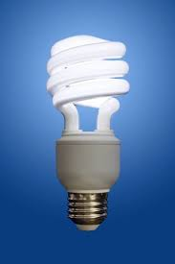
Let’s look at Lightbulbs
3 types of lightbulbs – Which is Best?
Incandescent
Compact Fluorescent
LED
$0.75
$6.50
$15.00

Slide 3
Fill Out this Chart
60
$0.75
600
$13.40
1,000
$150.20
23
$6. 50
1275
$5.07
8,000
$68.25
10
$15.00
1550
$2.20
25,000
$34.96
250
$4.30
10000
$55.08
5,000
$569.37

Slide 4
Let’s look at Lightbulbs
3 types of lightbulbs – Which is Best?
Compact Fluorescent
Incandescent
LED
Now…Which bulb do you think is the best?

